Slide 1

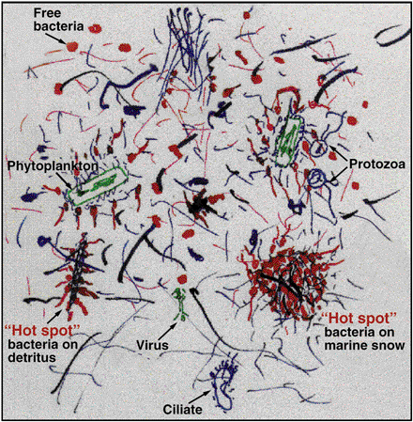
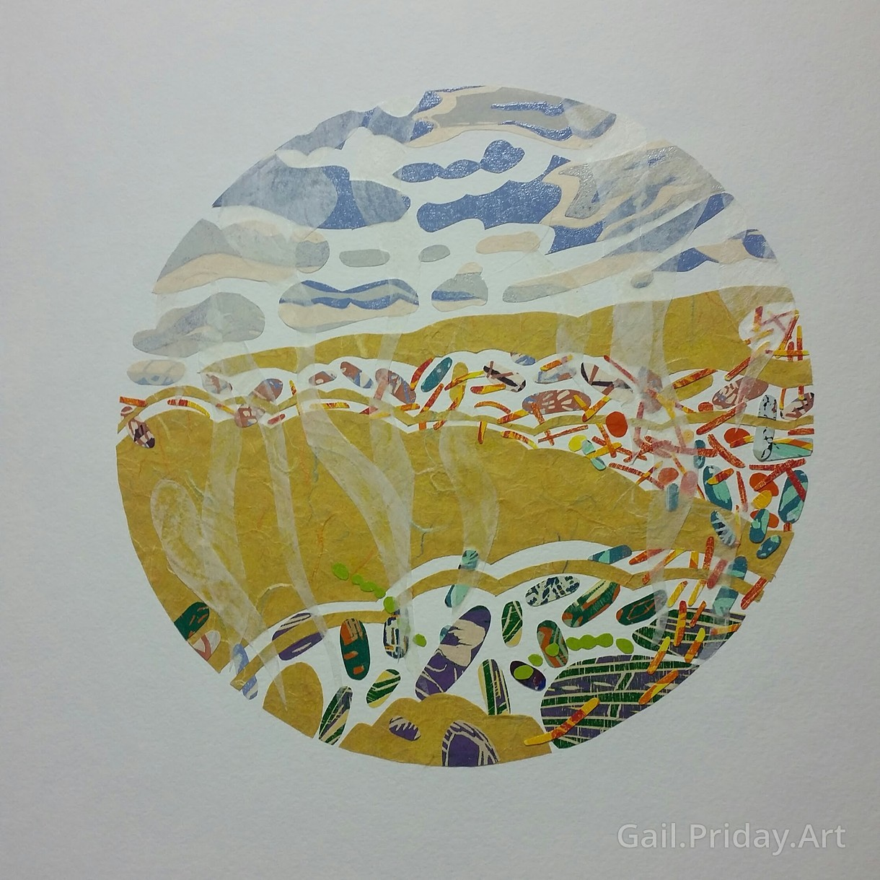
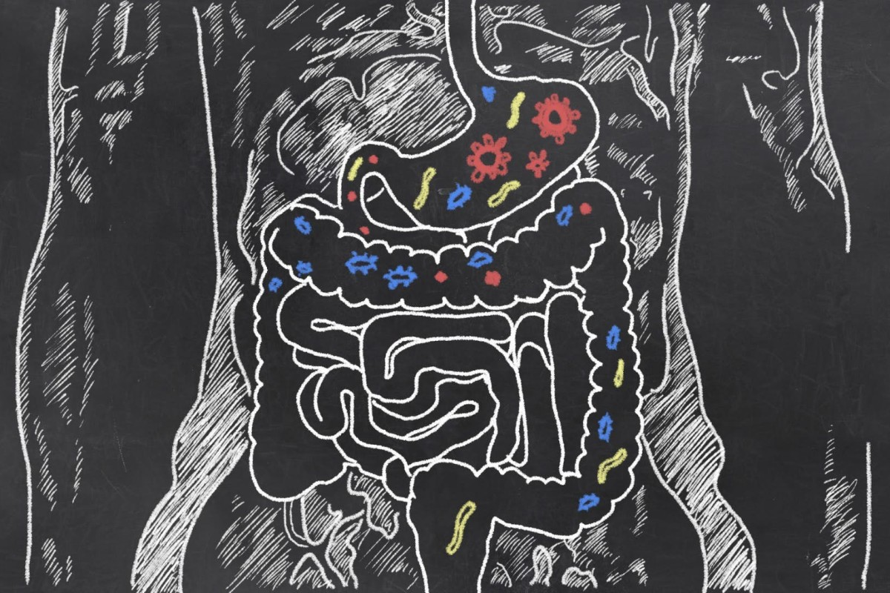
Metagenomics Lesson 8
biovcnet.github.io

Slide 2
Lesson 8 – Binning
What & why
How does binning work
Methods & tools
Complementary approaches
Demo
Notes:
Overview of the structure

Slide 3
What is binning?
Grouping sequenced & assembled DNA sequences from a metagenome into separate draft genomes.
Currently largely restricted to Bacteria & Archaea
Possibly a “transient problem”

Slide 4
Why do binning?
Discovery of novel organisms
Insight in trait and organism evolution
Predicting community interactions
Physiology hypothesis generation

Slide 5
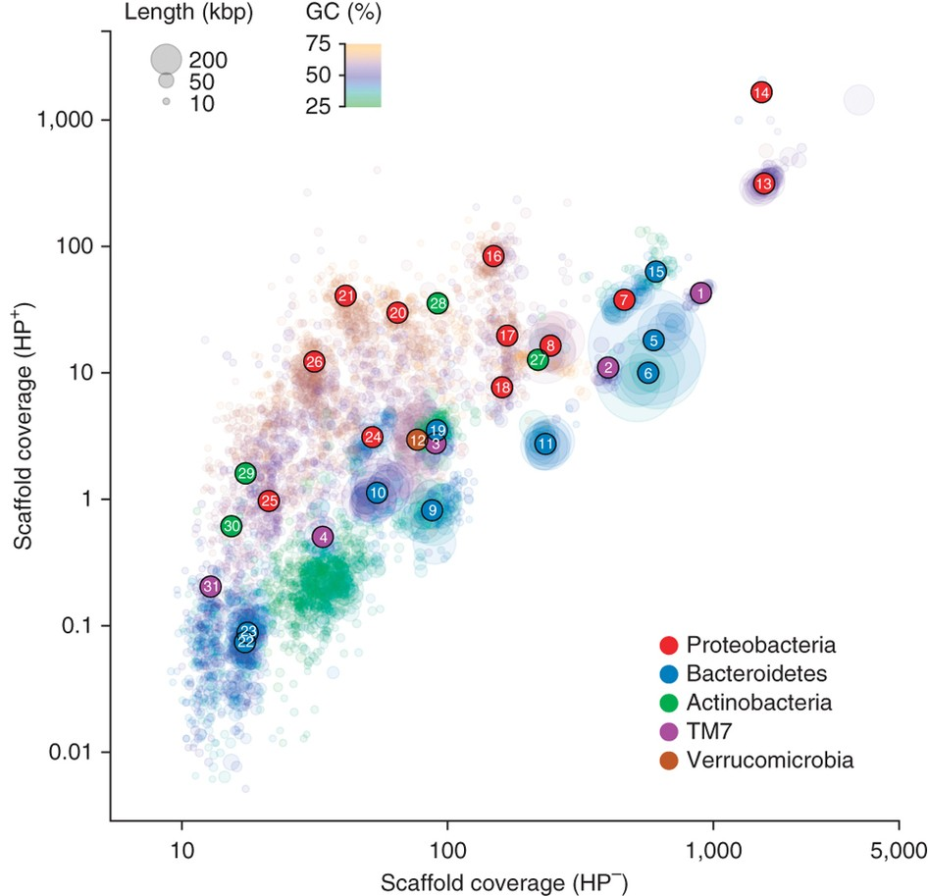
How does binning work?
Takes advantage of conserved features across the genome.
Sequence composition
Abundance of the DNA
Taxonomic affiliation (of encoded features)

Slide 6
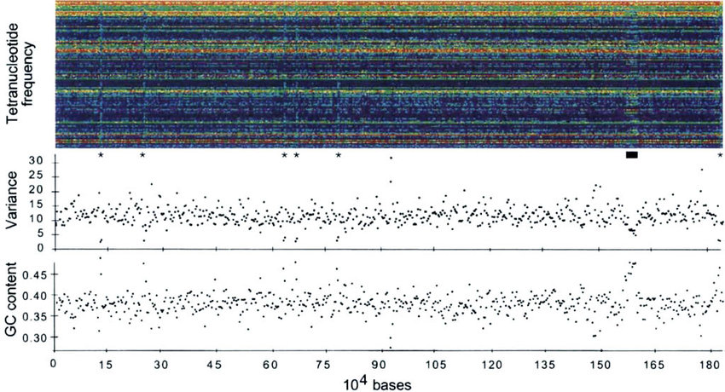
Lesson 2: Sequence composition is conserved in a genome
At the level of 4-mers (aka “tetranucleotide frequency”), bacterial genomes have conserved “fingerprints” which are used in metagenomic binning tools and to detect horizontal gene transfer events.
This figure shows an H. influenzae genome, where each column is the 4-mer fingerprint of a 3000 bp region and each row is a 4-mer colored from low abundance (purple) to high (red).
Starred (*) sections contain ribosomal RNA. The black bar identifies a bacteriophage.
Noble et al. (1998).

Slide 7
Lesson 5: Coverage depends on genome relative abundance
genomic library
4 dominant species
G
E
N
O
M
E
C
O
V
E
R
A
G
E
Abundant species >> moderately abundant species > rare species
10X coverage of species 1
0.5X coverage of species 4
Abundant groups: Draft Genome Assembly Possible
Rare groups: Only Read-Based Analysis Possible
Notes:
7
Mostly a Frank slide

Slide 8
In practice: binning by sequence composition and abundance

Slide 9
In practice: binning by differential abundance

Slide 10
In practice: binning by differential abundance

Slide 11
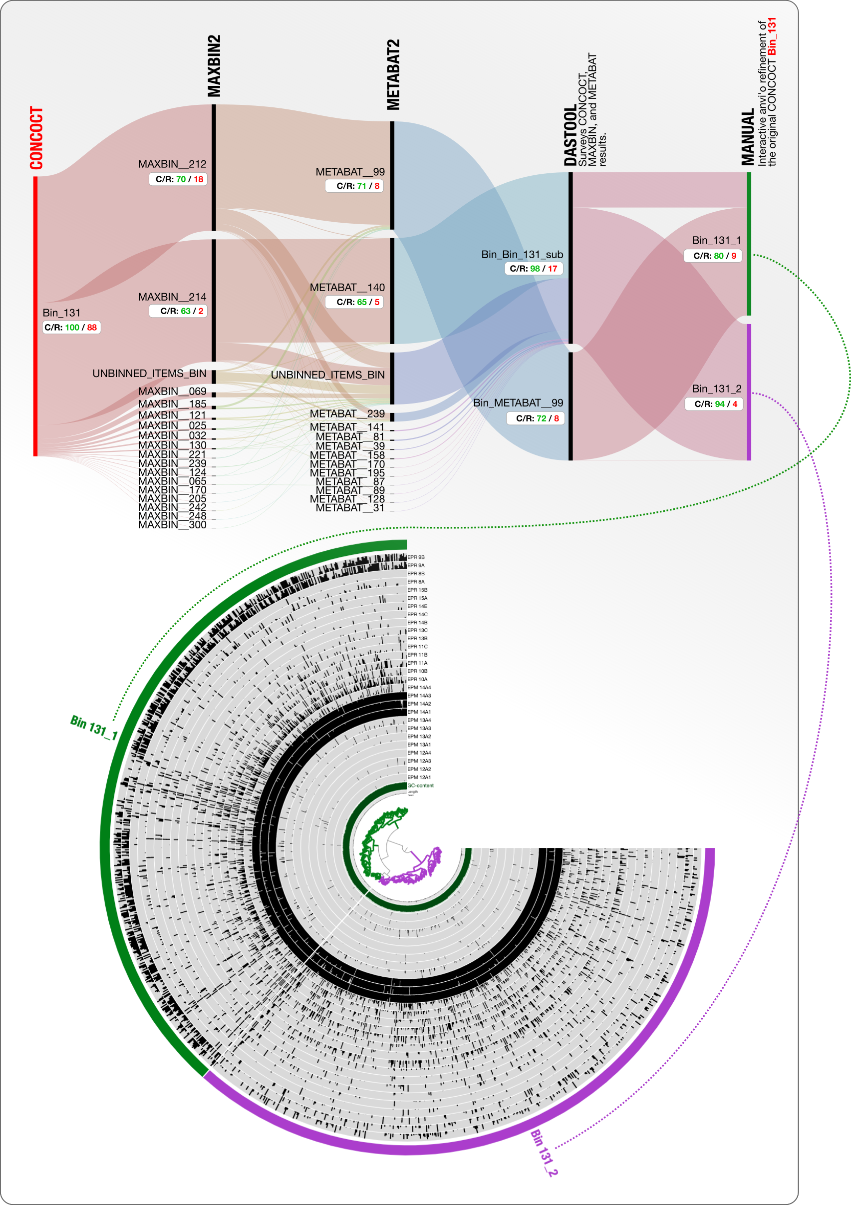
Binning approaches: “Manual”
mmgenome (Albertsen et al 2013)
anvi’o (Eren et al 2015)
ESOM (Dick et al 2009)
Composition based matrix & dimensionality reduction (tSNE/PCA/UMAP)
Low throughput but tailored decisions per bin
Reproducibility can be challenging

Slide 12
Binning approaches: Automated
Many tools, often relatively easy to run.
Use the same underlying information, but weigh different
Work best with higher number of samples
Subject of recent large scale evaluations (e.g. Meyer et al 2018)

Slide 13
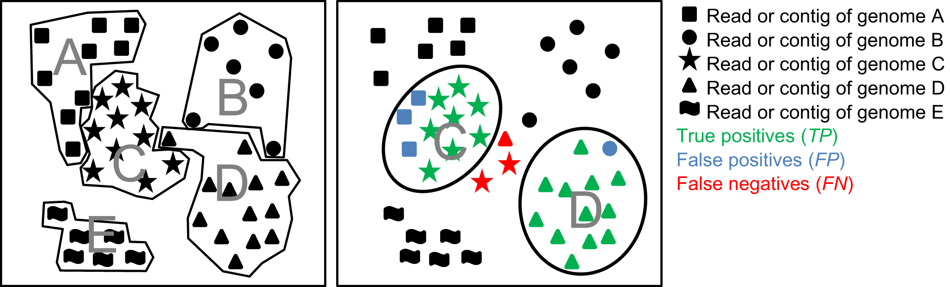
Possible errors in binning
Meyer et al 2018

Slide 14
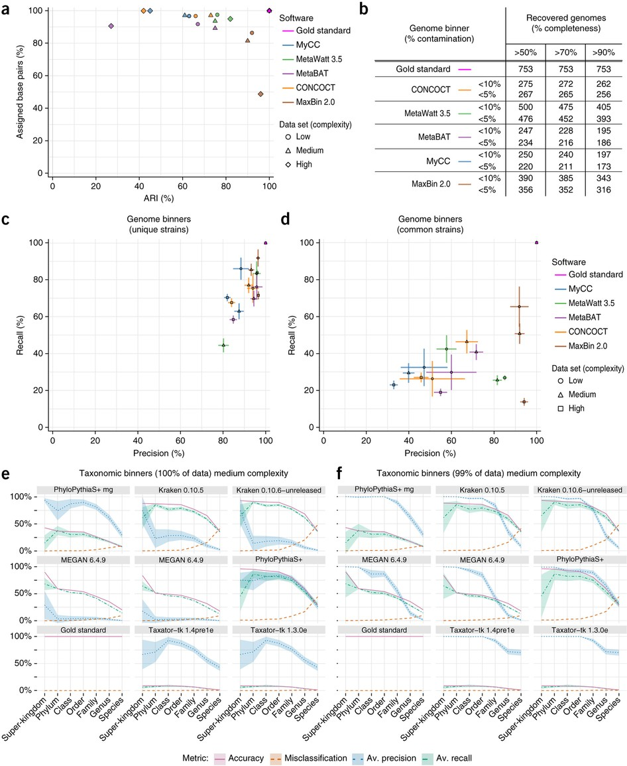
Evaluating binning approaches
CAMI (Szcyrba et al 2017) AMBER (Meyer et al 2018)

Slide 15
Binning approaches: Metabat 2 (Kang et al 2019)
Based on tetranucleotide frequency (TNF) and coverage (ABD)
Contigs are assigned a score S S = sqrt(TNF^{(1−w)} * ABD^{w} * COR) where w = nABD/(nABD + 1)
Builds a graph of contigs initially based on TNF Contigs = nodes, similarity = edges
Binning by graph partitioning: modified label propagation algorithm
Post partitioning recruiting of: short contigs (< 2500bp) & contigs in small bins (< 200k)
Criterion: avg S similarity to contigs in bin is greater than avg S similarity between contigs in bin

Slide 16
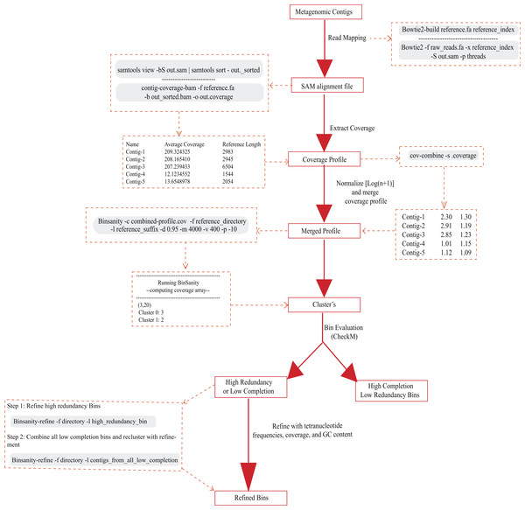
Binning approaches: Binsanity
(Graham et al 2019)
Coverage based
Affinity propagation: Each contig is tested as “cluster center”
Evaluation of bin quality
Bin refinement with composition if needed

Slide 17
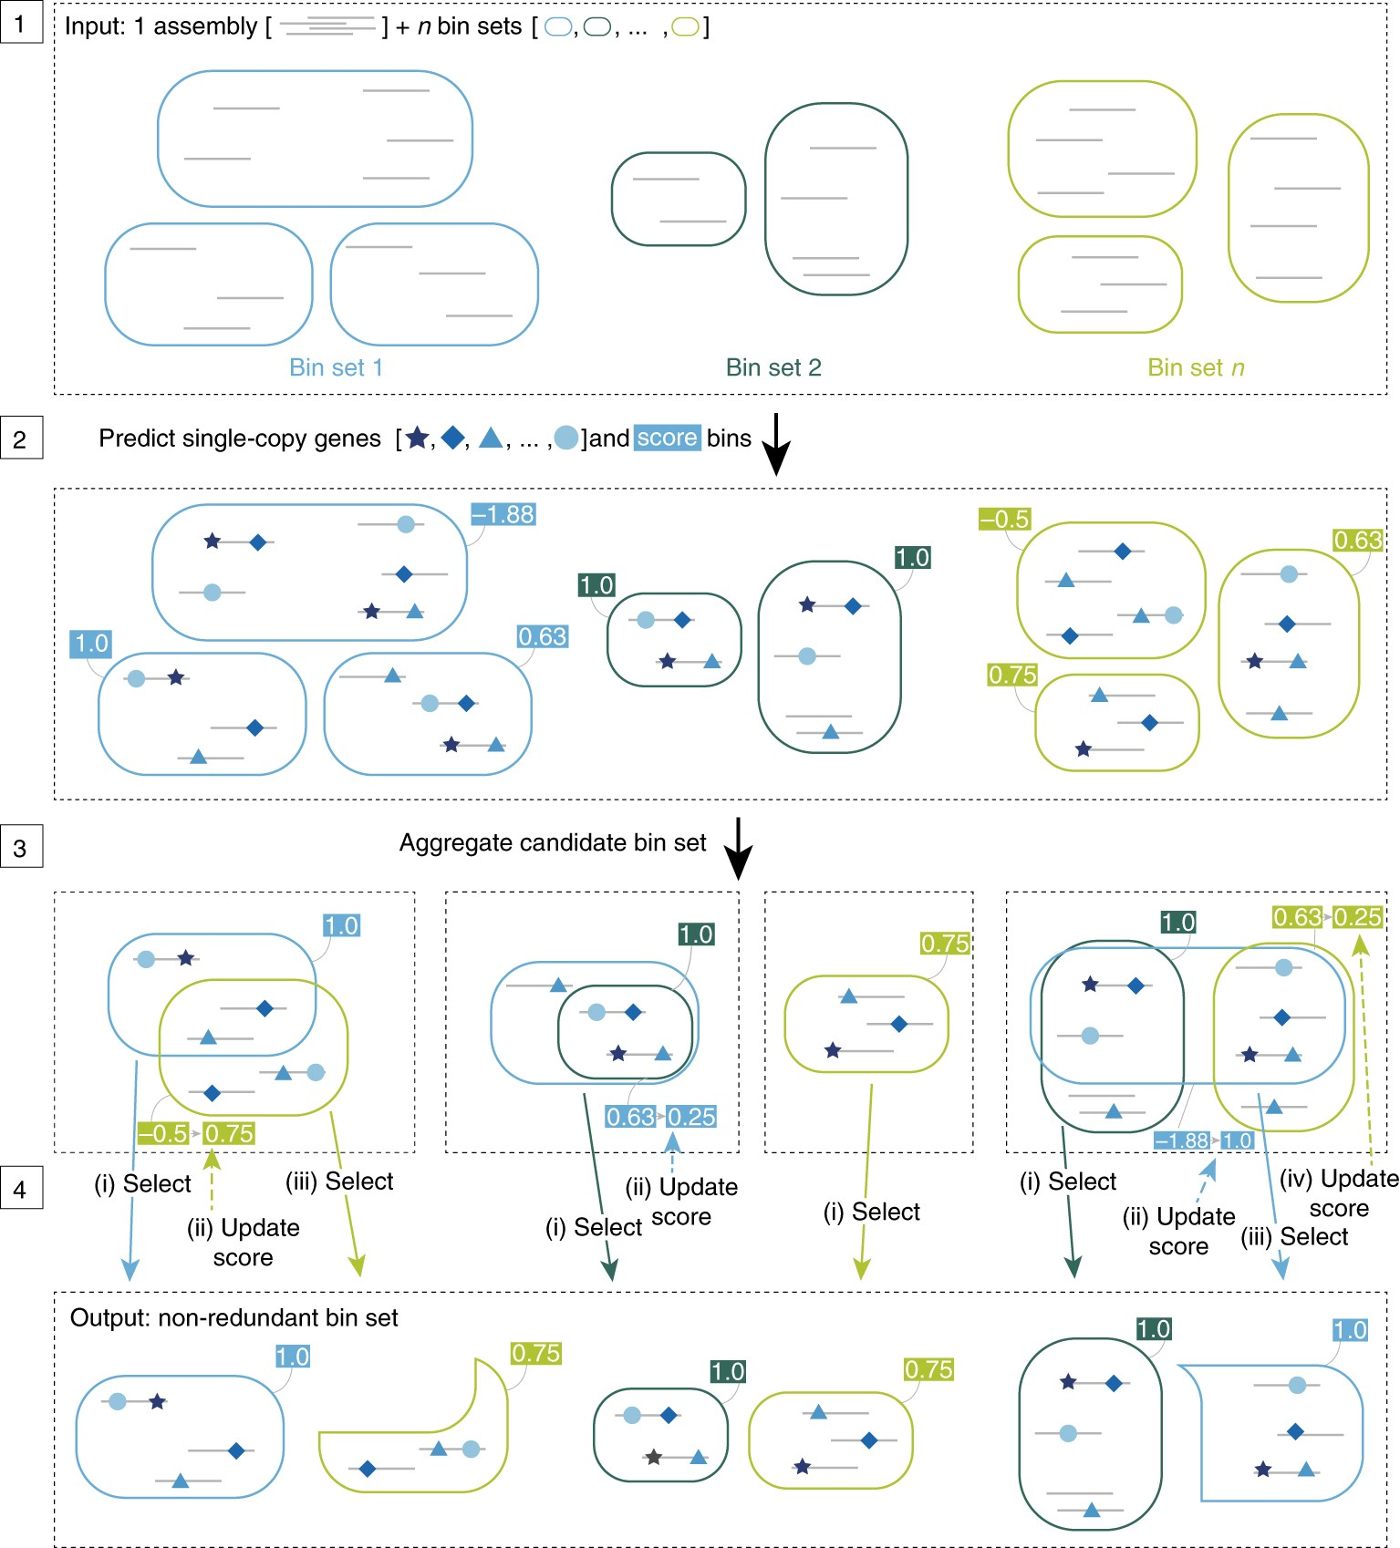
Binning approaches: DAS Tool (Sieber et al 2018)
Binning aggregator
Scores each bin based on single copy markers:
Picks bin based on: Score > N50 > total length
Rescores new bin set -> repeats

Slide 18
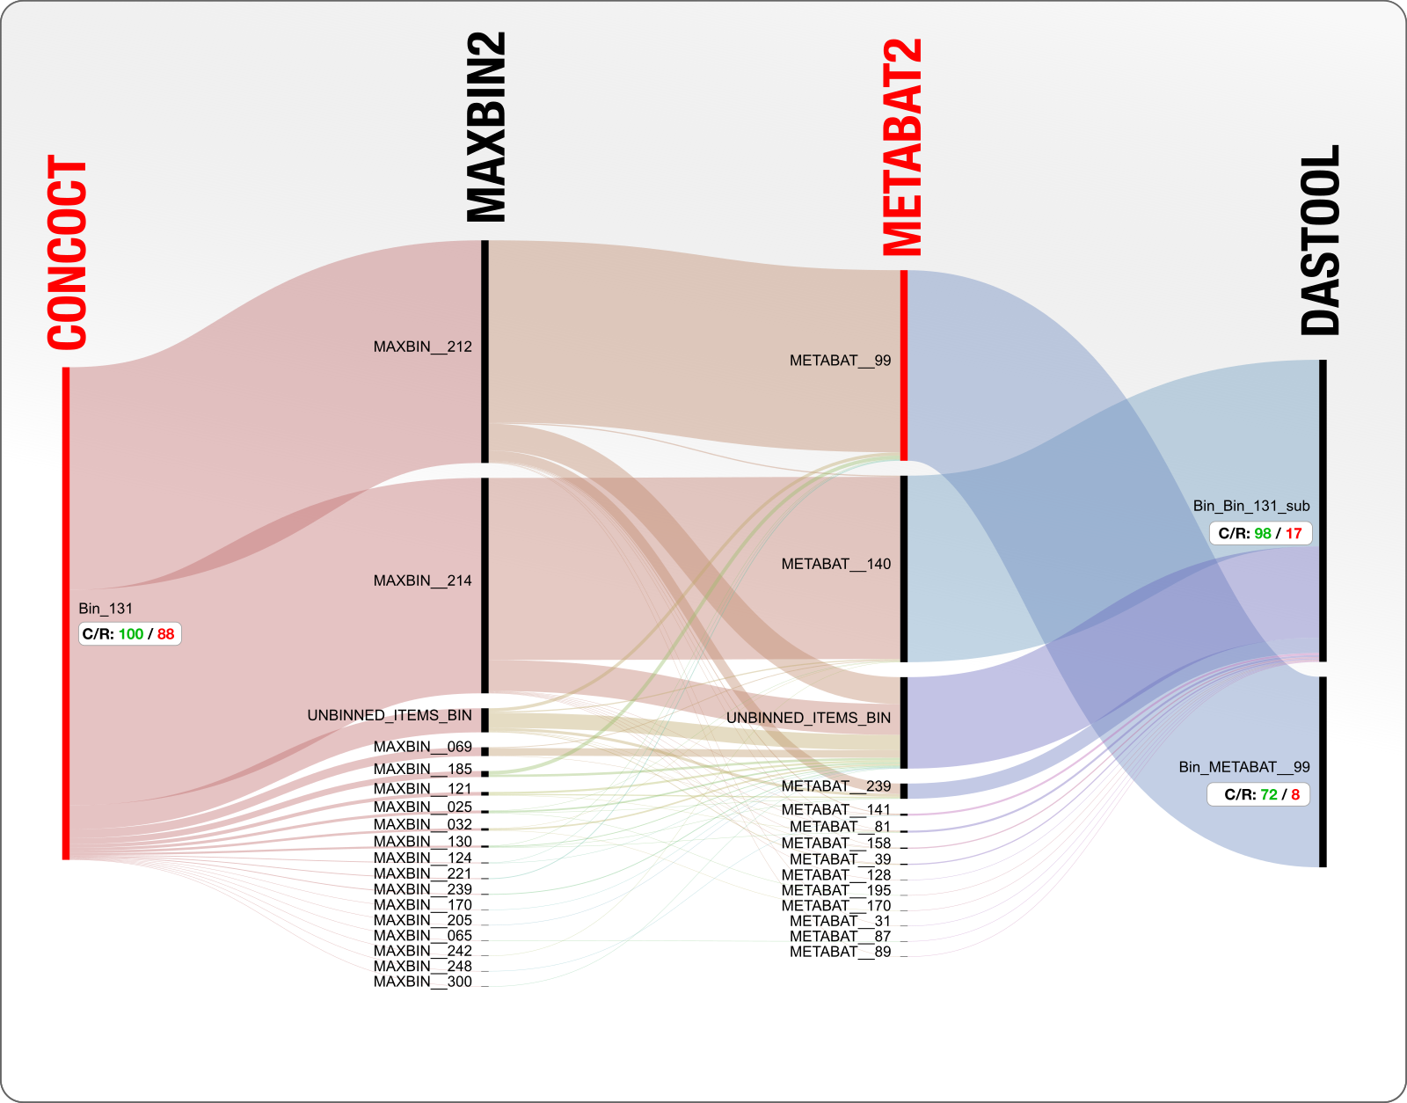
More binning evaluations:
http://merenlab.org/2020/01/02/visualizing-metagenomic-bins/

Slide 19
Complementary methods: Single cell genomics
Sorting of individual cells & MDA amplification
Pros: individual genotypes, population variation, rare cells
Cons: poor completeness (but improving), more lab intensive, lower throughput
Much info available, could be it’s own topic

Slide 20
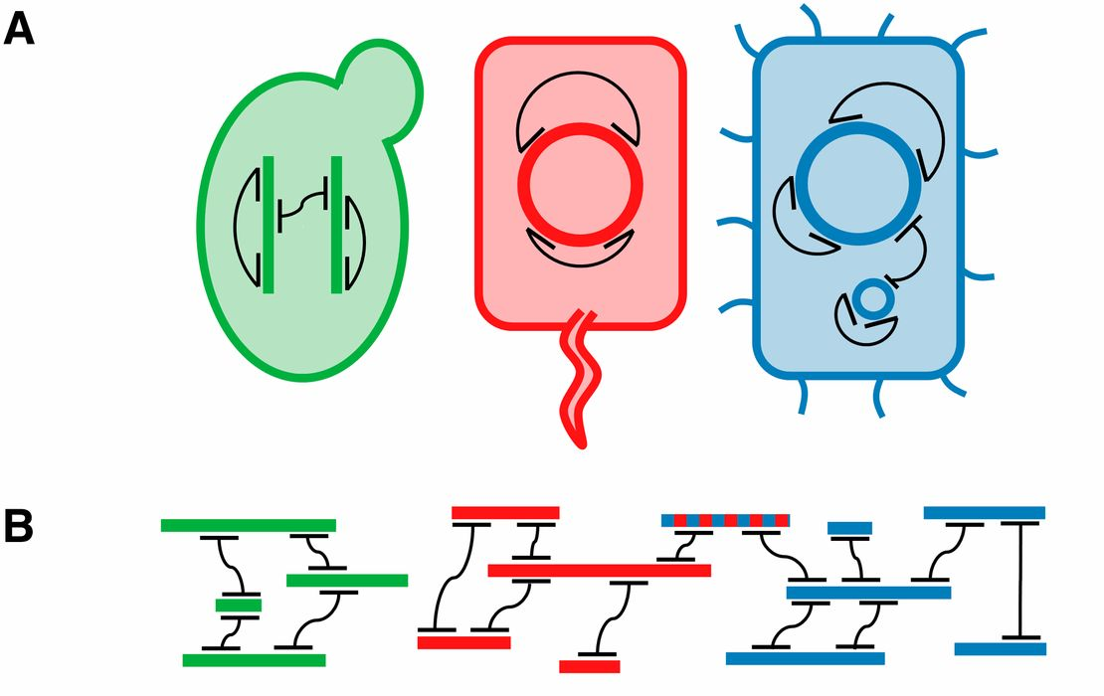
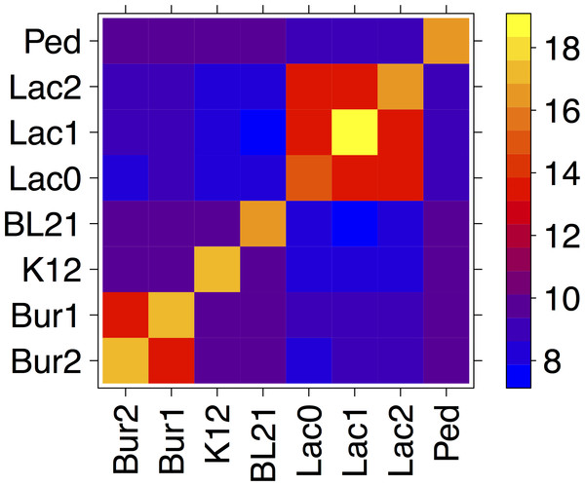
Complementary methods: Hi-C metagenomics
Crosslinking replicons before lysis.
Proximity linkage: digest and re-ligate crosslinked DNA
Sequence proximity linked DNA and untreated sample. Use links to bin assembly from untreated sample
Can resolve individual replicons with a cell. (Beitel et al 2014, Burton et al 2014)

Slide 21
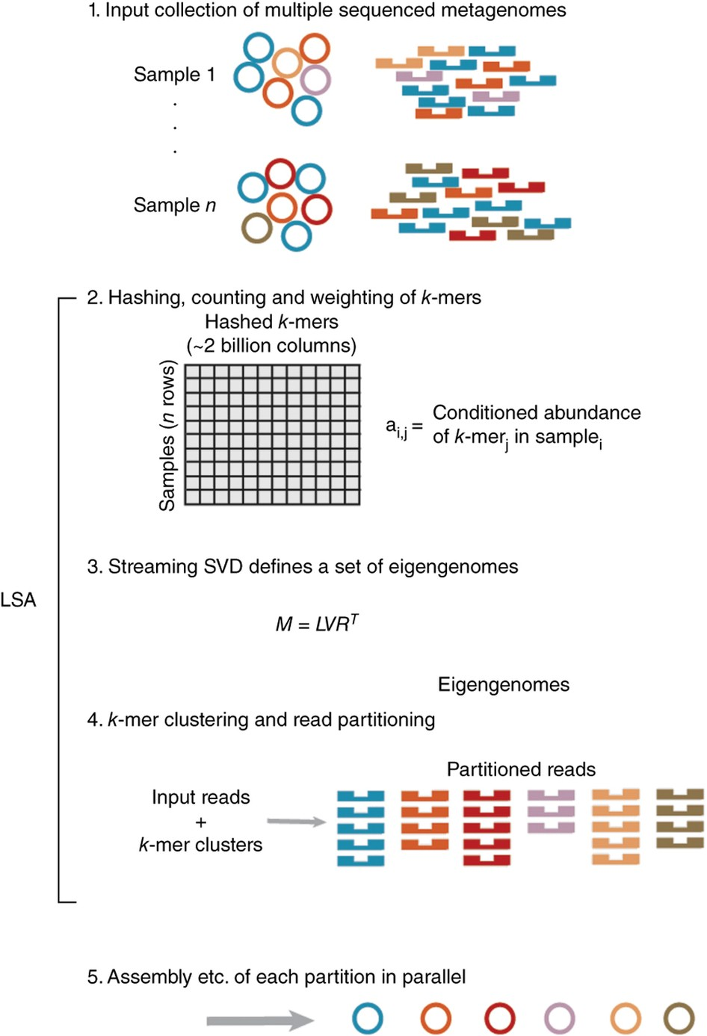
Analogous methods: Read partitioning
Using long k-mer presence/abundance to group reads into partitions.
Early binning tools (e.g. MetaCluster 5.0, Wang et al 2012 )
LSA (Cleary et al. 2015)
LSH - Sparse coding (Kyrgyzov et al. 2020)
Notes:
Alleviates assembly troubles for collections of massive datatsets, possibly better for strains?, possibly better for rare orgs?

Slide 22
Analogous methods: Assembly graph query
Rather than “flattening” the assembly graph into contigs, directly extract the relevant areas from the graph
(possibly) emerging approach
Implementation: Spacegraphcats (Brown et al 2020)
Allows deconvoluting strain variation
Notes:
Alleviates assembly troubles for collections of massive datatsets, possibly better for strains?, possibly better for rare orgs?

Slide 23
Binning approaches: Demo
Short review of: Metabat/Maxbin/CONCOCT/Binsanity
Demo of DAS tool using example data

